Slide 1
Applied Studies - Food Technology
Year 9 or 10

Slide 2
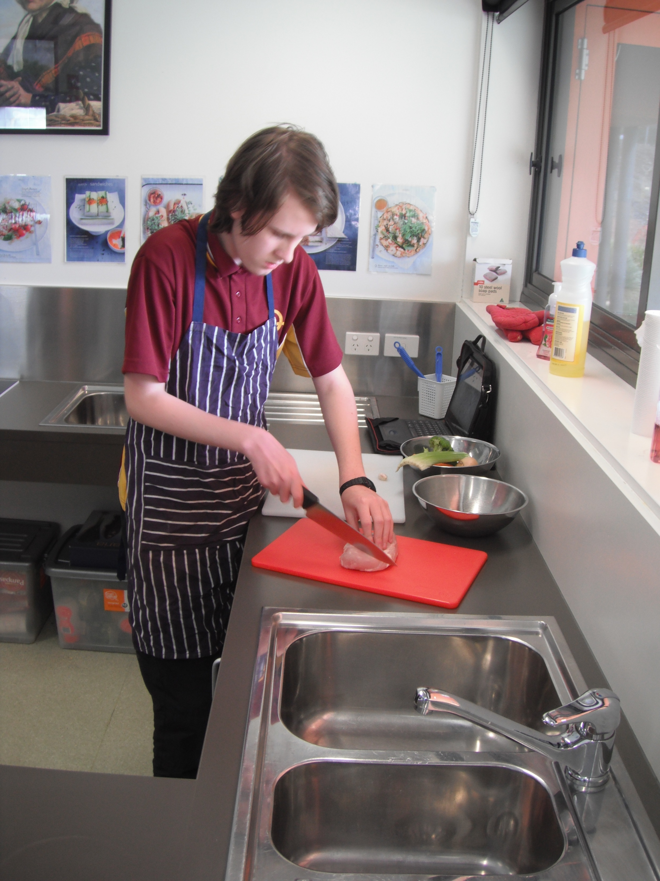
Food Technology
1 year course
Prepares students for a Hospitality pathway
Cooking only, no textiles
Design challenges:
Knife skills, Desserts, International Foods, Take away foods, Morning Tea, Finger food, Cakes
Food presentation, hygiene and safety focus

Slide 3
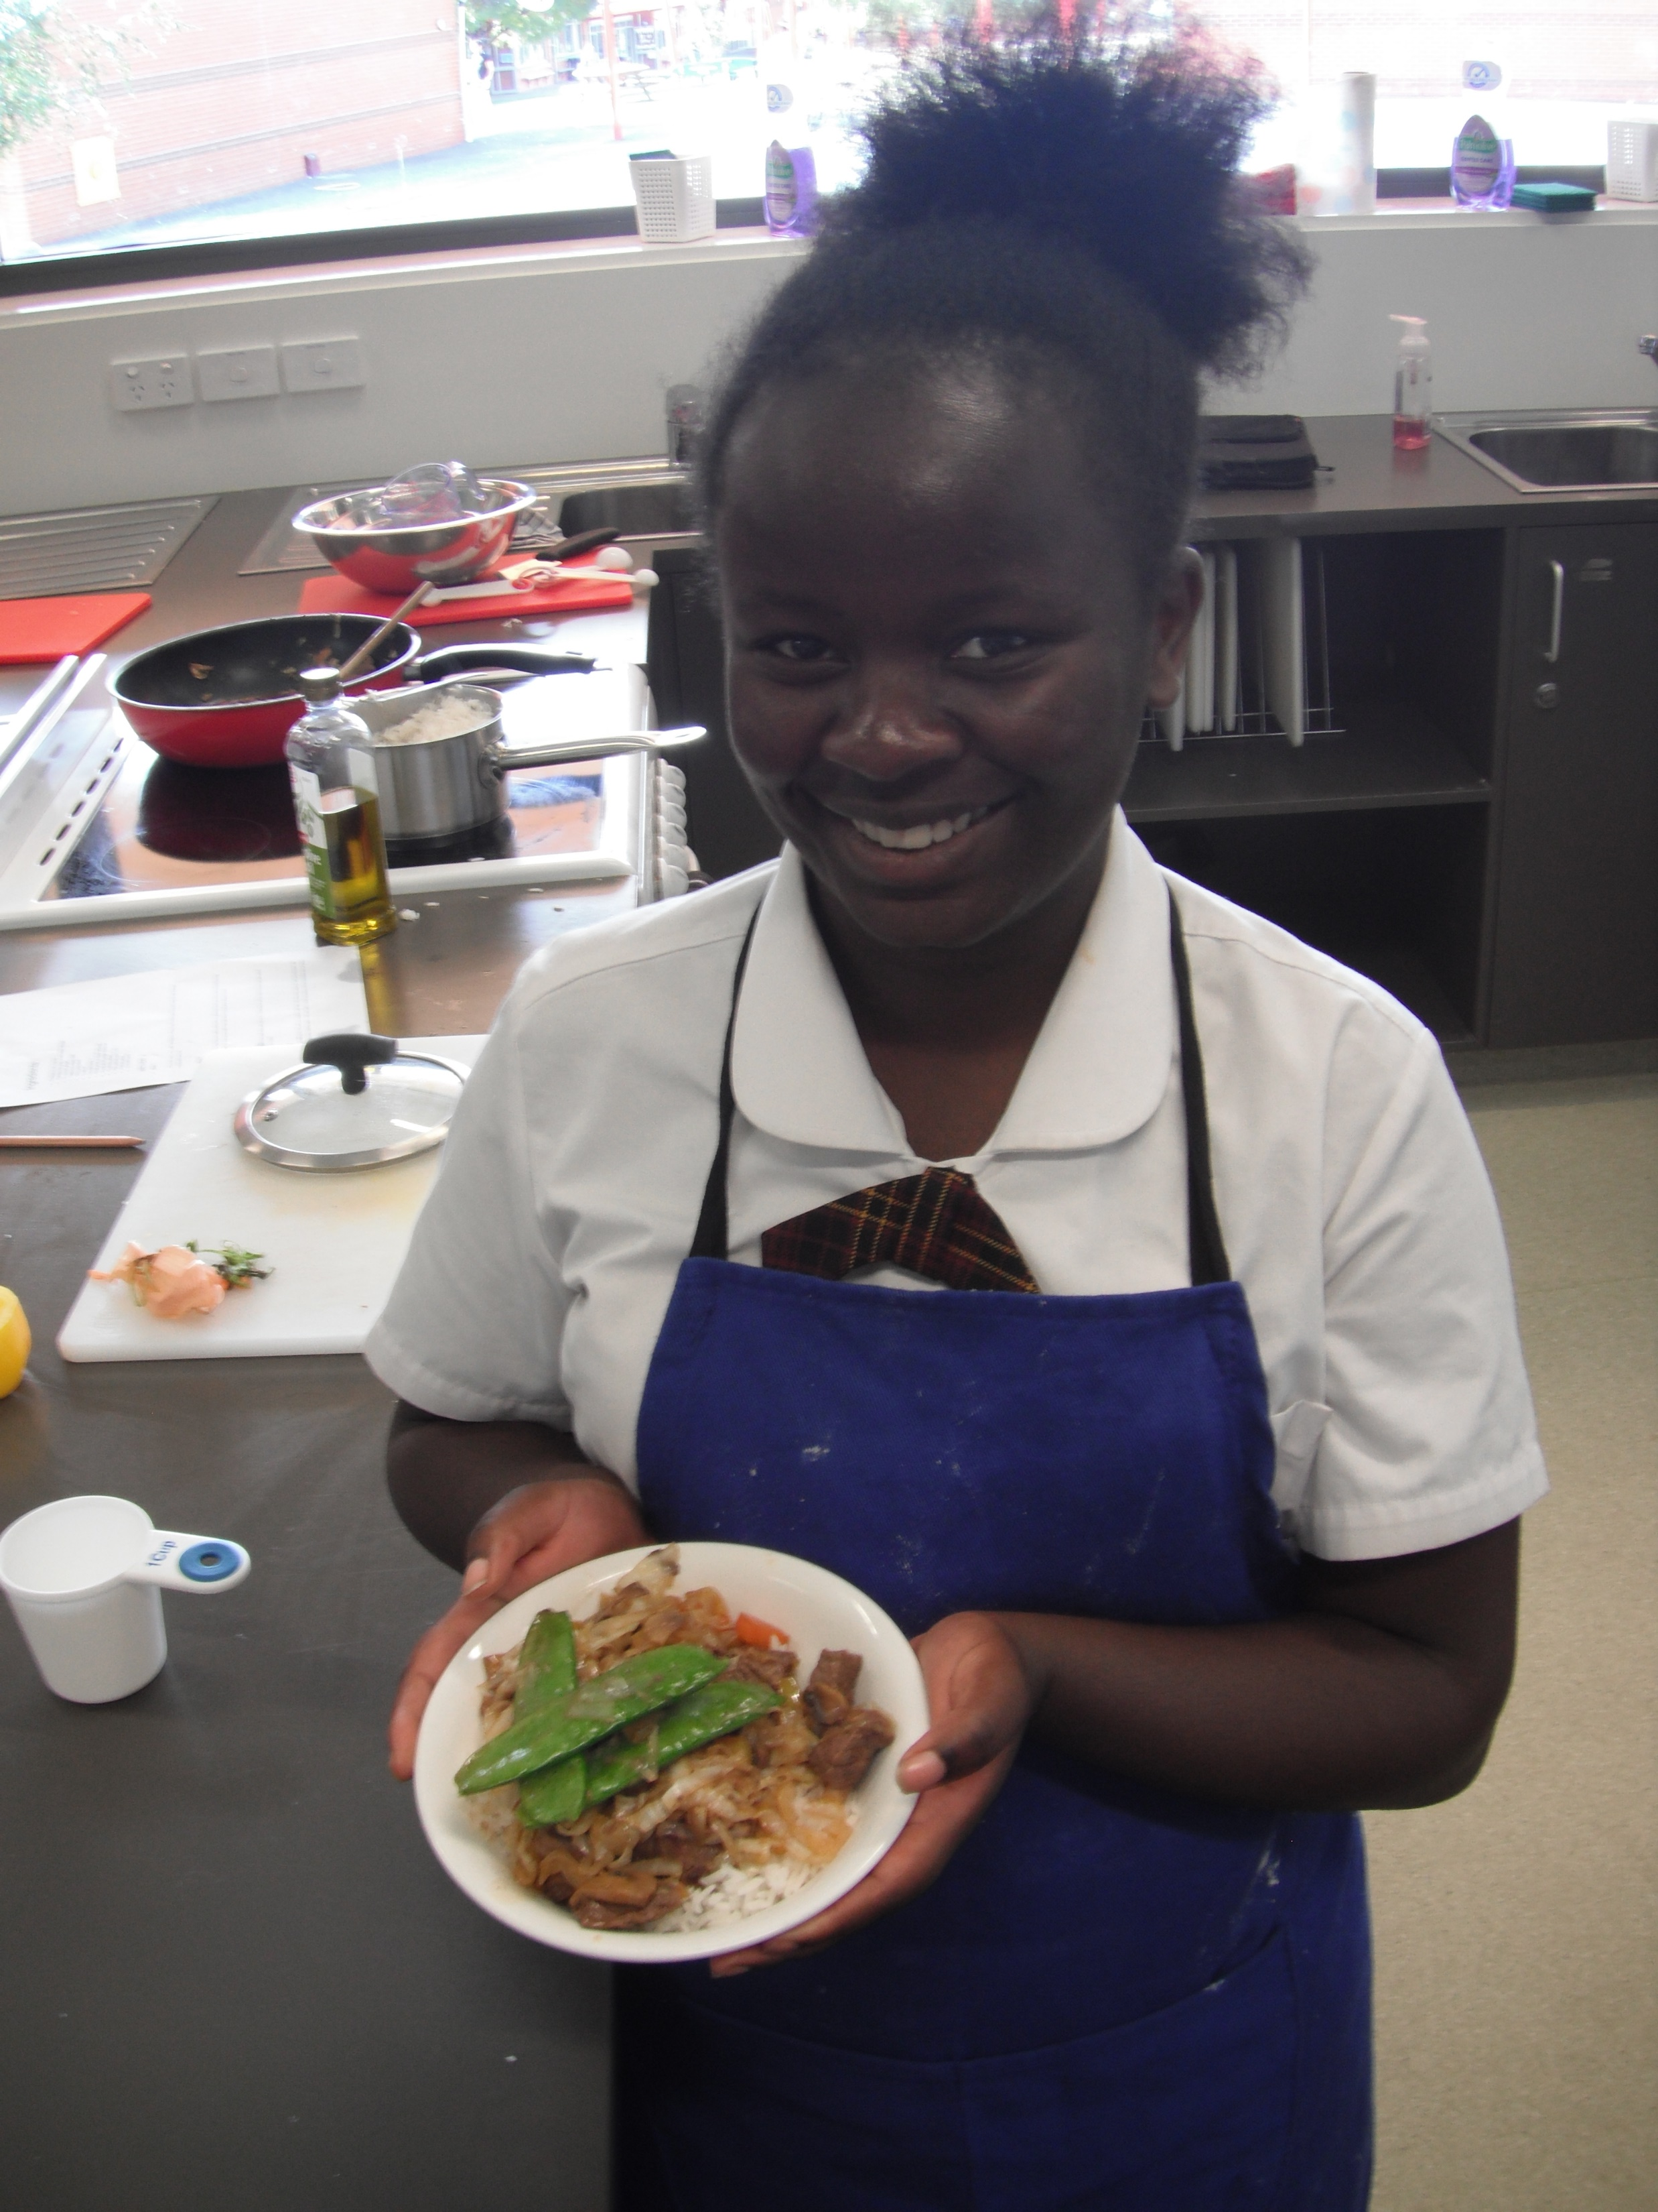
Food Technology
Learn about food labelling and packaging
Develops problem solving and critical thinking skills
Investigate personal, social, economic and cultural influences on food choices and eating habits
Explore sustainable food choices and sustainable food production

Slide 4
Find out more…
Please feel free to contact Mrs Selina Kinne, Head of Technology and Applied Studies, at skinne@dominic.tas.edu.au

